Slide 1
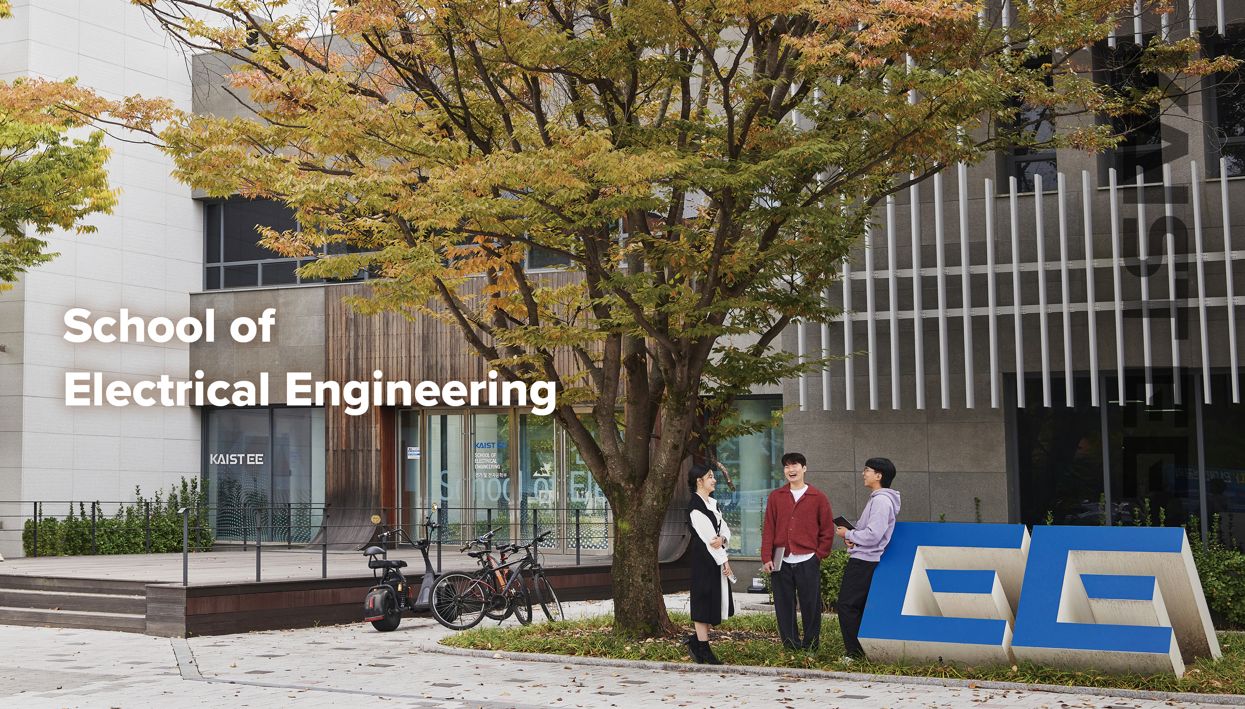

Slide 2
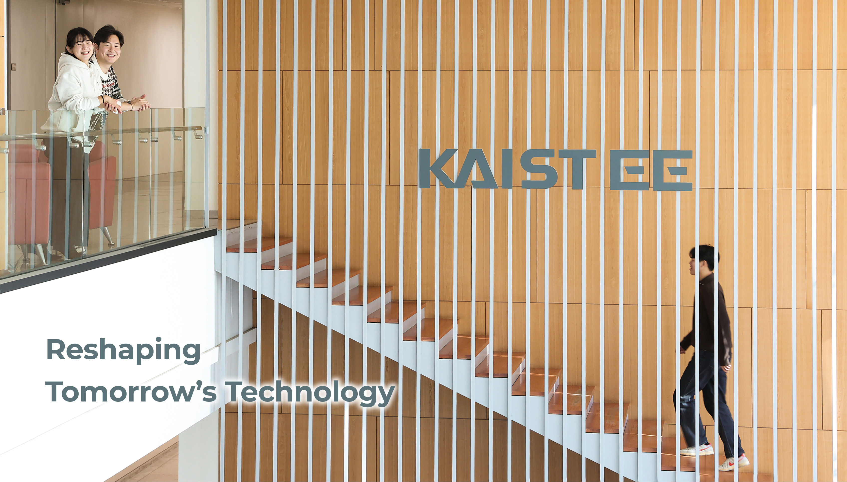

Slide 3



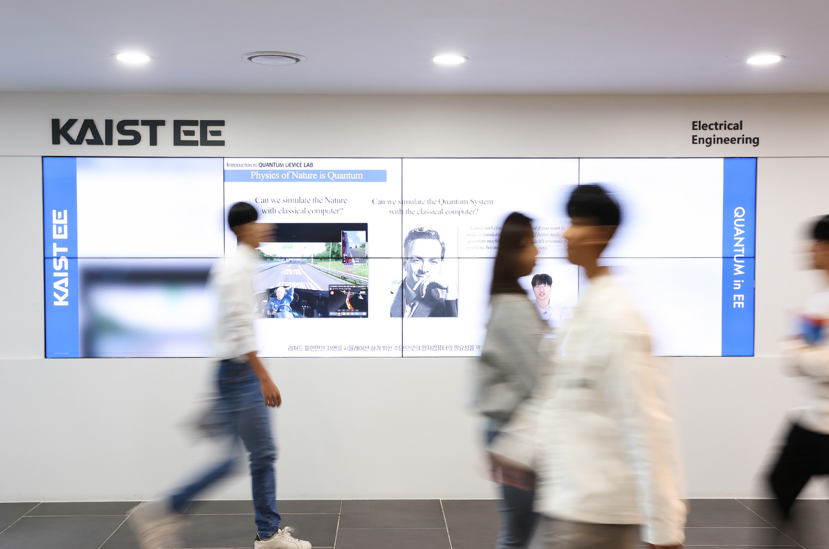
Vision
The School of Electrical Engineering is
striving to serve as a cradle for innovative
technology that will better serve the world.
Mission
The School of Electrical Engineering is
committed to advancing new innovations,
nurturing future thought leaders through
interdisciplinary and multidisciplinary
education, and conducting groundbreaking research crucial for making a significant
impact on the world.

Slide 4

Architect of Korea’s IT Dominance
Strategic Collaborations
Dynamic partnerships with government and industry
Research and Educational Innovation
Cutting-edge research and innovative educational initiatives
Historic Breakthroughs from KAIST EE
CDC (Charge Coupled Device) research leading to the creation of 64K DRAM by Samsung in 1975
Development of a 2-tesla MRI system in 1985
Creation of the 386 microprocessor and a supercomputer with 2.56 gigaflops in 1995

Slide 5
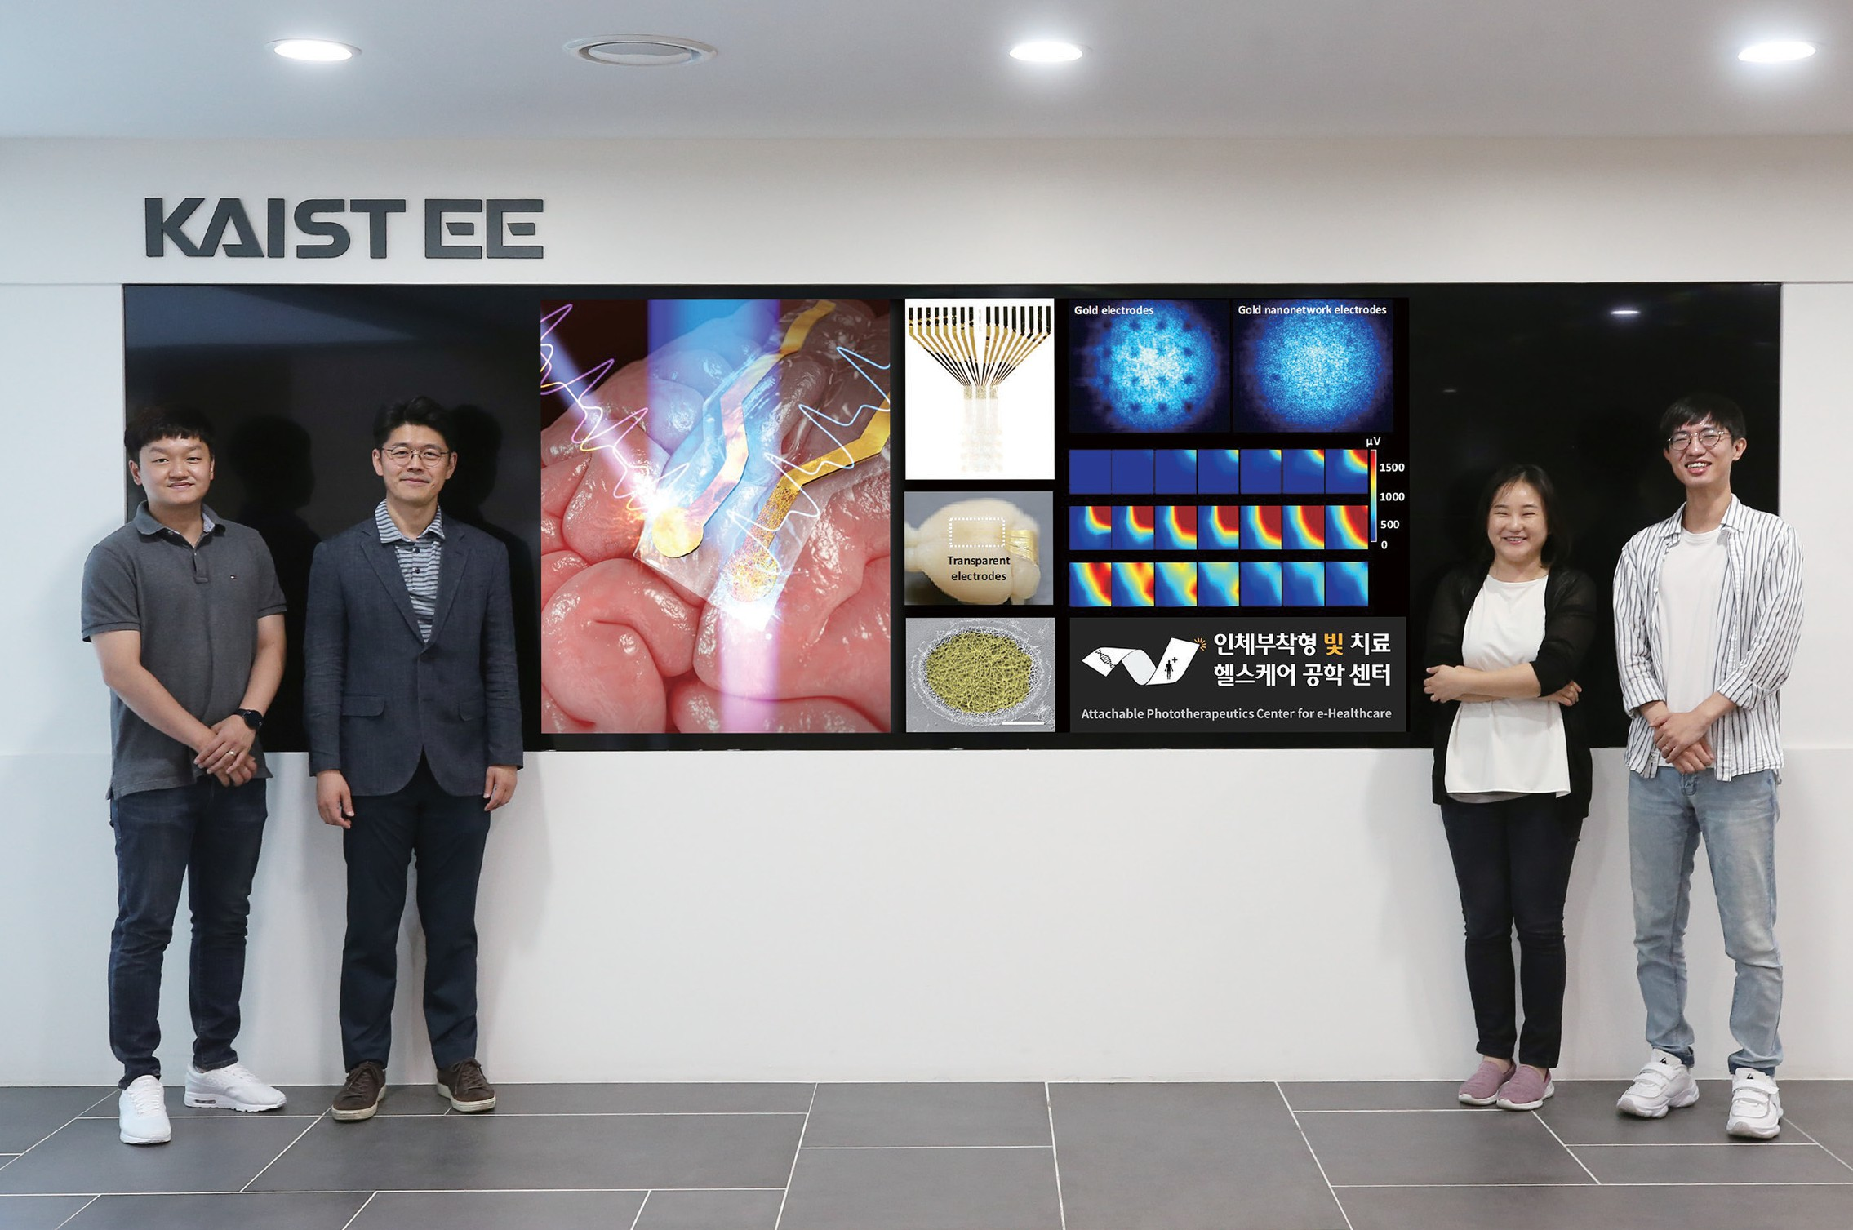
EE the Largest KAIST Faculty
6 Divisions
Department of
Semiconductor System Engineering
Graduate School of AI Semiconductor
Graduate School of Semiconductor Technology

Slide 6
EE by the Numbers
(as of fall 2023)
Student Body
Undergraduate | 950
Master Course | 470
Ph. D Course | 765
International Students | 142
Dual Degree | 1
Exchange Students | 16
Total | 2202
Startups
Faculty | 12
Student | 155
Patents & Technology Transfers
Patents Registered (domestic) | 1,006
Patents Registered (global) | 373
Technology Transfers | 6.4 million USD
Research Centers & Labs
Research Centers | 39
Labs | 87
Faculty & Staff
Full Time Professors | 88
International Faculty | 8
Post-doc/Research Professors | 39/7
Adjunct Professors | 9
Emeritus Professors | 44
IEEE & ACM Fellows | 23
Administrative Staff | 23
Publication
Avg publications per year in SCI/SSCI journals | 410
20% of our publications are in the Top 10% of journals
Research Grants
140 million USD/Year

Slide 7




EE by the Numbers
(as of fall 2023)
Alumni Career Path
Global Reputation
QS Ranking | 23rd (2023)
Electronic Circuits | 1st in ISSCC for 14 consecutive years
Machine Learning and AI | 11th in the number of papers published in collaboration with the Graduate School of AI in ICML, the highest level in Asia in the fields of computer vision, AI, and deep learning
Computer Vision & Computer Architecture | 4th in the CSRankings
Computer Systems | 9th in the CSRankings
Ph.D
BS & MS
Academia
11%
Others 9%
Academia
5%
Public Sector
1%
Others
11%
Research
Advanced Studies
31%
Institutes
20%
Industries
43%
Industries
57%
Public Sector
1%
Research Institutes
11%

Slide 8
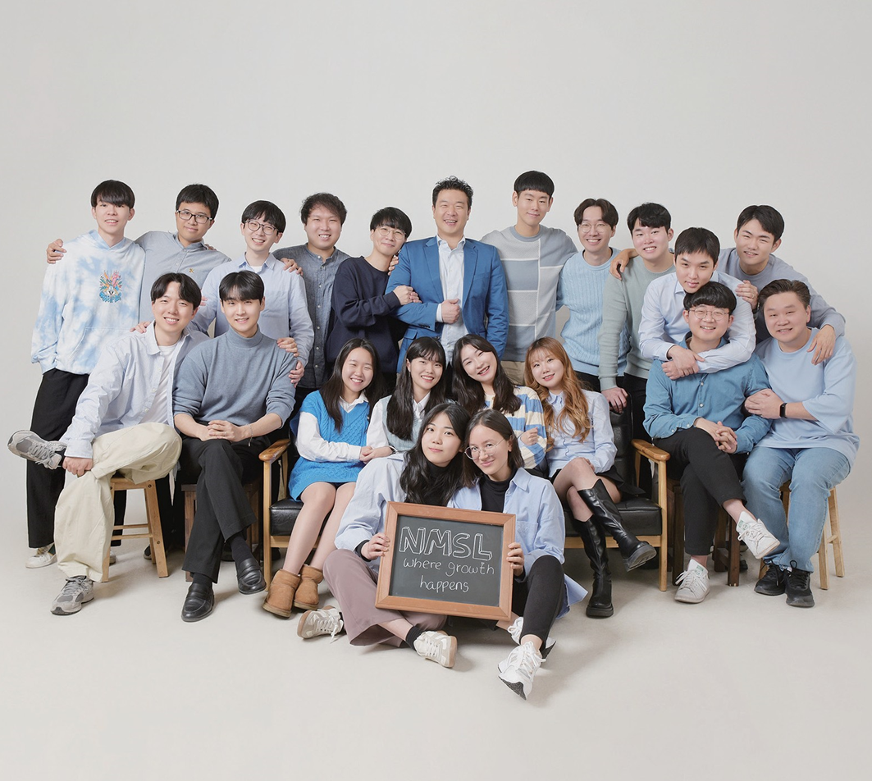
Education
Where the Brightest Minds Unite, Think Outside the Box, and Push the Boundaries

Slide 9

Education
Innovative Thinking and Real-World Problem Solving
Fostering creative thinking to tackle real-world challenges
Integrated Research-Education Approach
Emphasis on grasping core principles and their application through integrated research and education
Hands-On Experimental Courses
Focus on practical, hands-on experimental learning
Interdisciplinary + Advance Tech Centric Courses
162 interdisciplinary courses + over 40 courses in AI, machine learning, big data, and quantum computing
Edu4.0 Integration
15 courses utilizing Edu4.0, KAIST's flipped e-learning pedagogy

Slide 10
6 Divisions
Circuit
Computer Signal
Communication
Device Wave

Slide 11

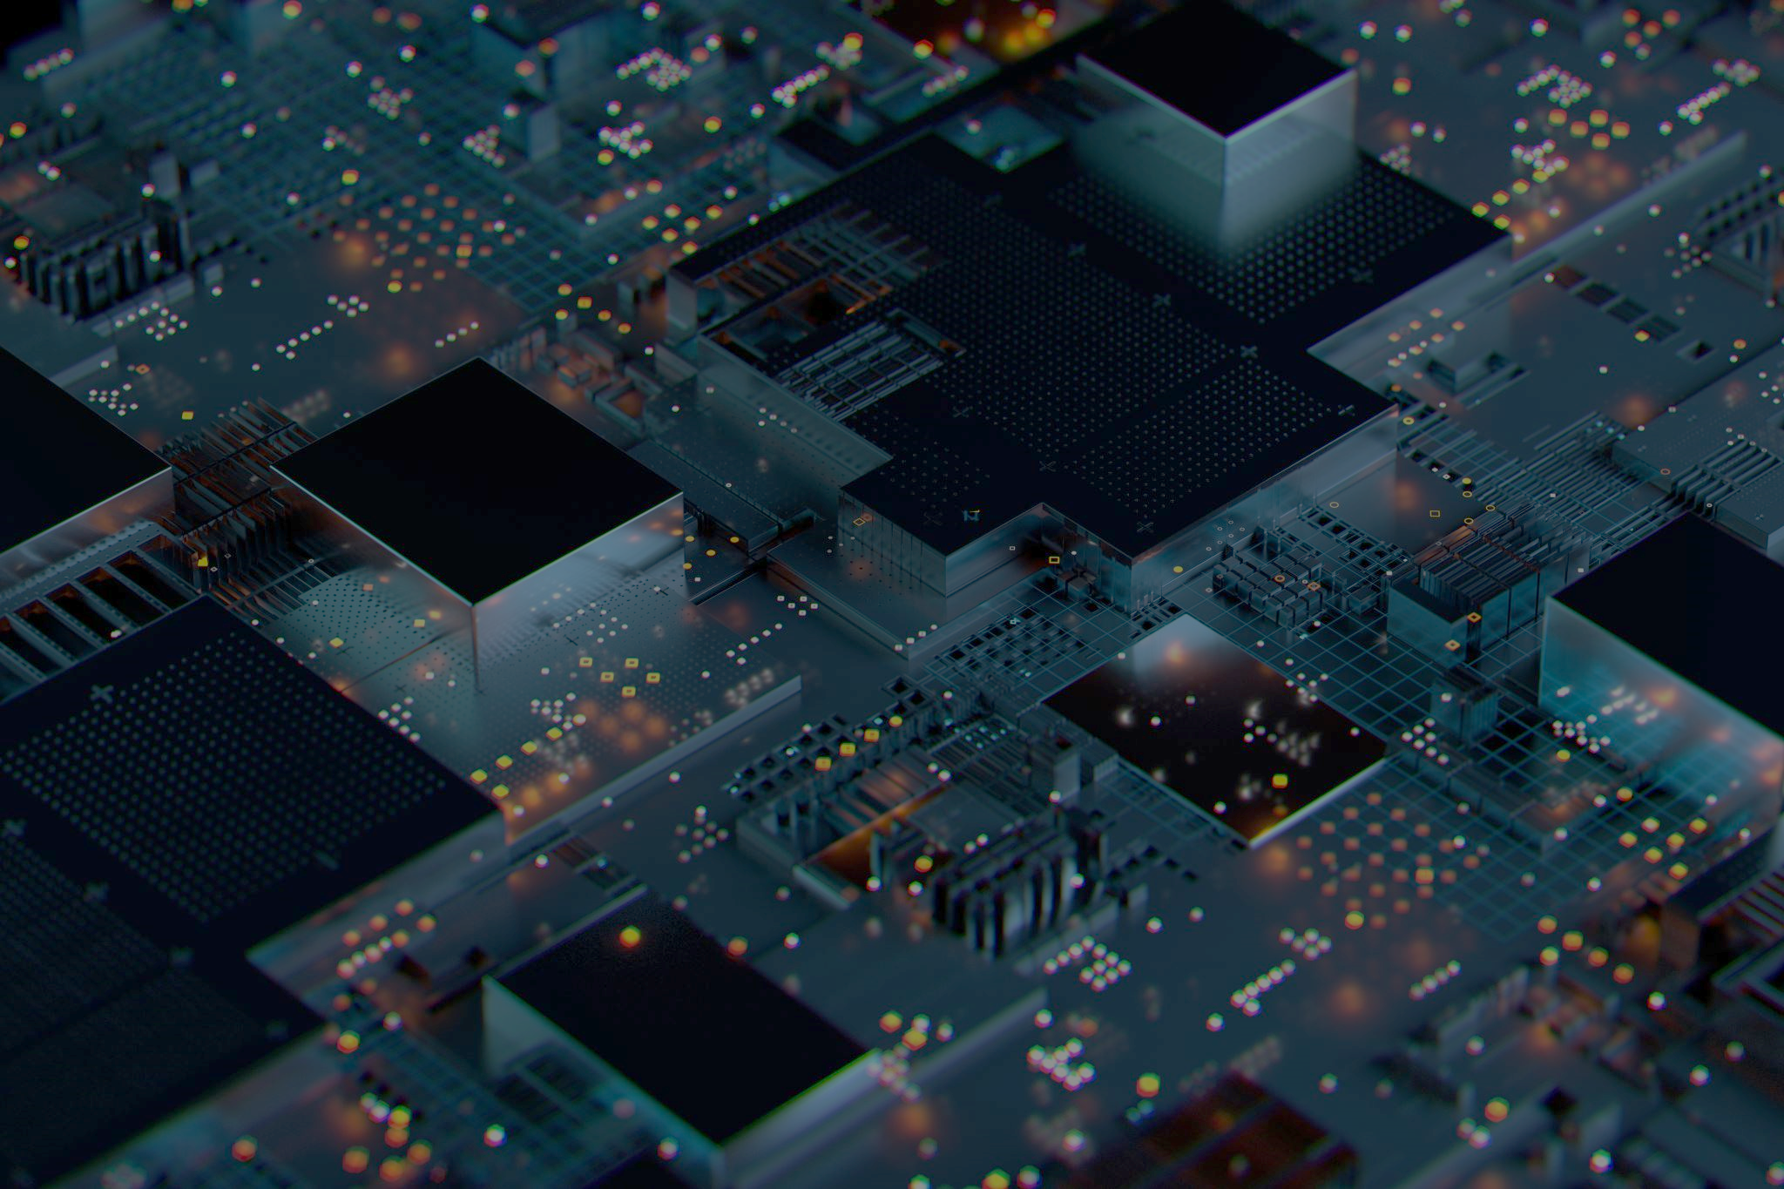
Circuit Division
IC Theories & Applications
Sensors and High -performance Mixed-Signal ICs
Power/Battery Management ICs
Display and Multimedia ICs
VLSI and AI Processors
Wireline/Wireless Communications and Interfaces
Biomedical Systems and Circuits
CAD and AI-assisted Lithograph

Slide 12

Communication Division
Communication
Machine Learning
Data Science
- Non-terrestrial networks
- mmW beamforming
- Unmanned vehicle communication via 6G services
- Deep learning theory/
design/applications
- Reinforcement learning
- Meta learning
- Generative model
- Data processing/storage
- Data security/privacy/ fairness
- Quantum communication

Slide 13

Computer Division
Computer Architecture & Systems
Cloud & Network Systems
Mobile/IoT
System Security
Operating System
AI/ML/Data Science
Self-Driving Cars/Drones

Slide 14
Device Division
Nano/ Semiconductor Devices
Flexible Electronics & Display
Bio-Healthcare Devices
High Speed Electronics
Sensors and Wearable Devices
Quantum and Energy Devices

Slide 15

Signal Division
AI
Sound and Speech Processing
Computer Vision
LLM
Control
Robotics
Biomedical Imaging
Power Electronics

Slide 16

Wave Division
Photonics
Electromagnetic Waves
Quantum Science and Technology
- Photonic devices & systems
- Metamaterials & surfaces
- Photonic integrated circuits
- Optical communications
- Active antenna systems
- Radar signal detection
- Microwave circuits & systems
- Electromagnetic interference
- Wave theory
- Quantum computing
- Quantum communication
- Quantum sensing
- Quantum devices & systems

Slide 17
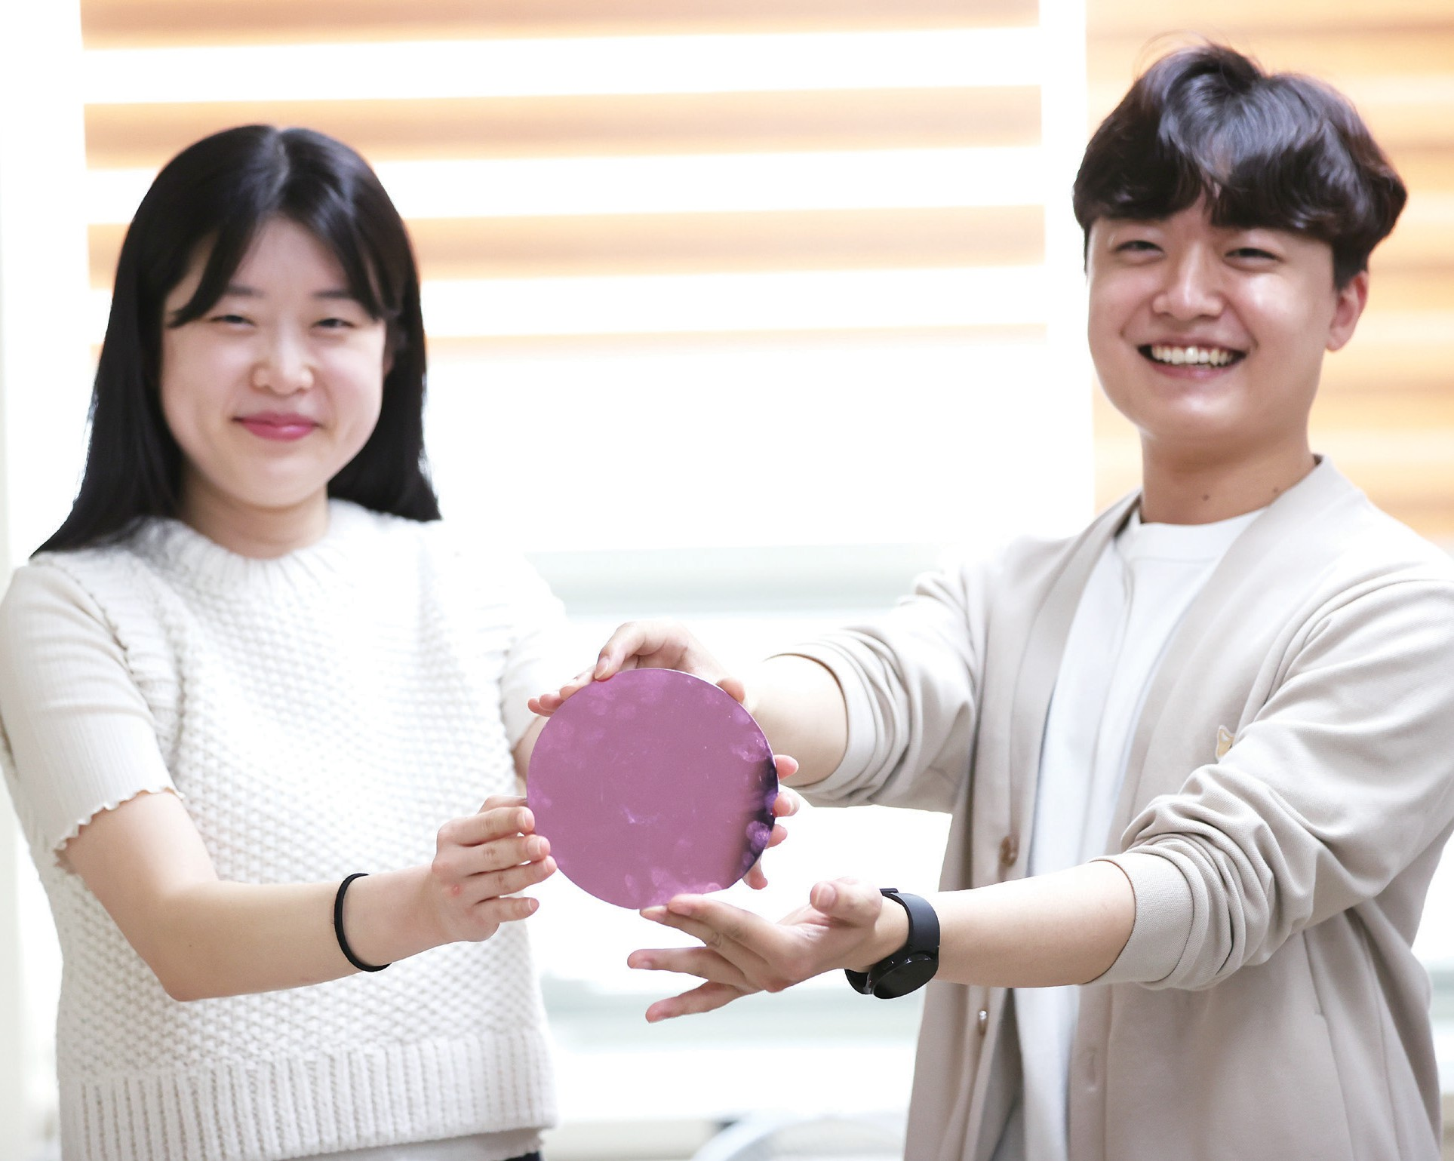
Semiconductor-Intensive Program
Department of Semiconductor System Engineering
Sponsored by Samsung Electronics, emphasizing practical education on semiconductor systems, circuits, components, processes, and software.
Aims to matriculate 100 undergraduates annually by 2026, destined for employment at Samsung
Graduate School of AI Semiconductor
Founded under the Ministry of Science and ICT’s AI Semiconductor Advanced Talent Development Project
Specialized curriculum covering AI system architecture, circuit research, and fostering industry-academia collaboration with global networking
Graduate School of Semiconductor Technology
Established via the government’s Semiconductor Specialization Graduate School Support Program
Focuses on interdisciplinary semiconductor education from concept to design, processes, components, and evaluation, fostering crucial figures in the semiconductor industry

Slide 18
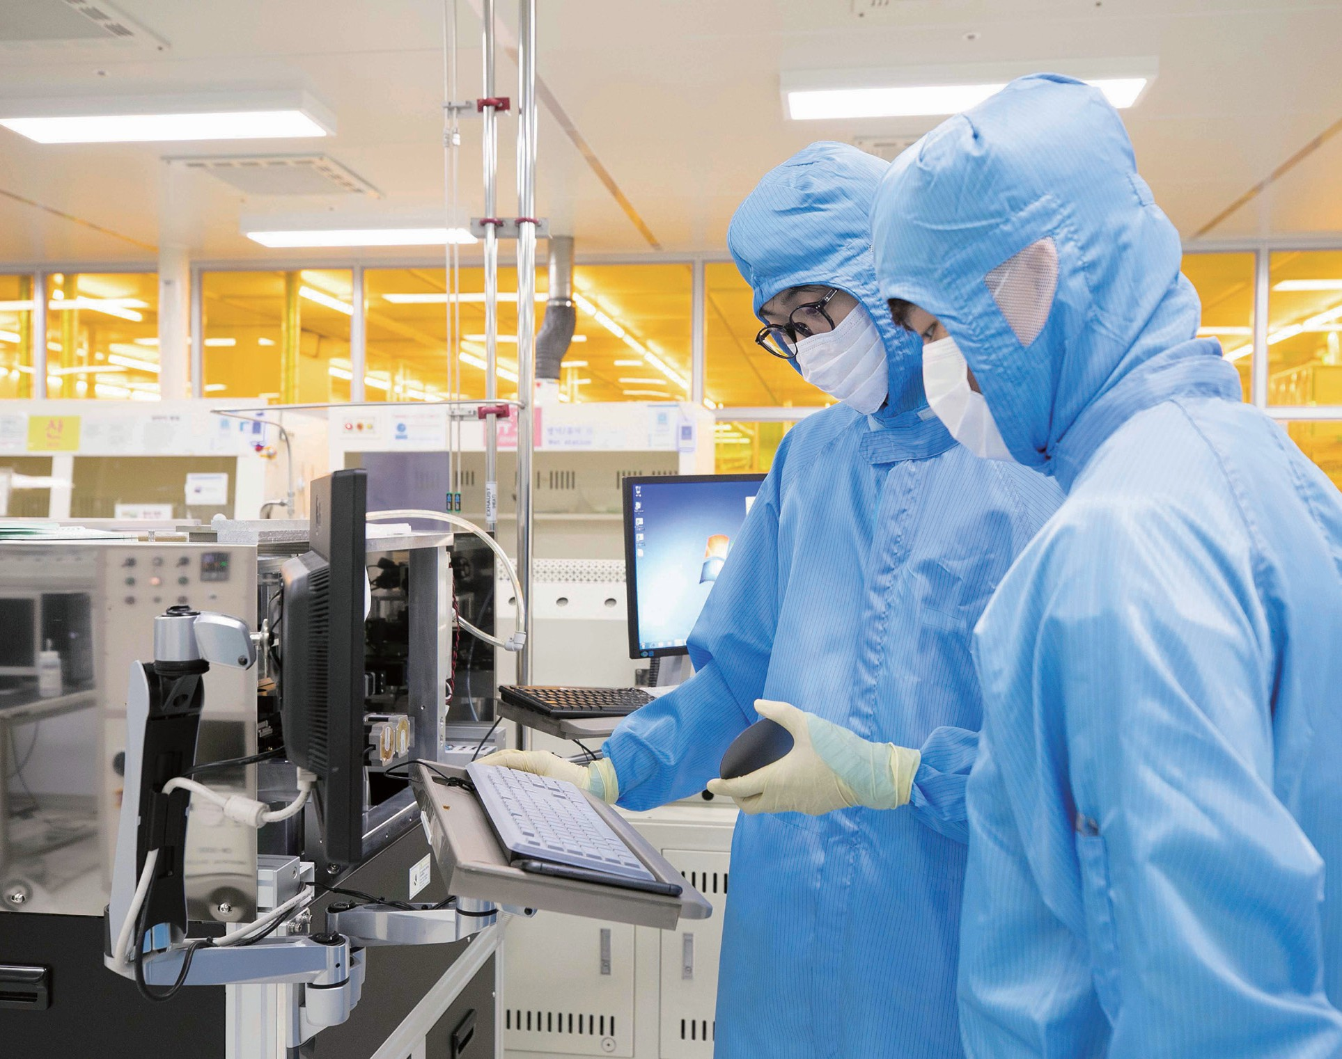



Industry Collaboration Program
Nurturing Real-World Problem Solvers
KAIST Educational Program for the Semiconductor Industry with SK Hynix (KEPSI)
Educational Program for Samsung Semiconductor (EPSS)
Lgenius Program
KAIST Future Mobility Program with Hyundai Motor Group
Educational Program for Samsung Display (EPSD)
KAIST Robotics Program with Samsung Electronics
Reskilling and Upskilling Programs
SK Hynix-KAIST ASK program
SeongNam-KAIST AI Intensive program

Slide 19
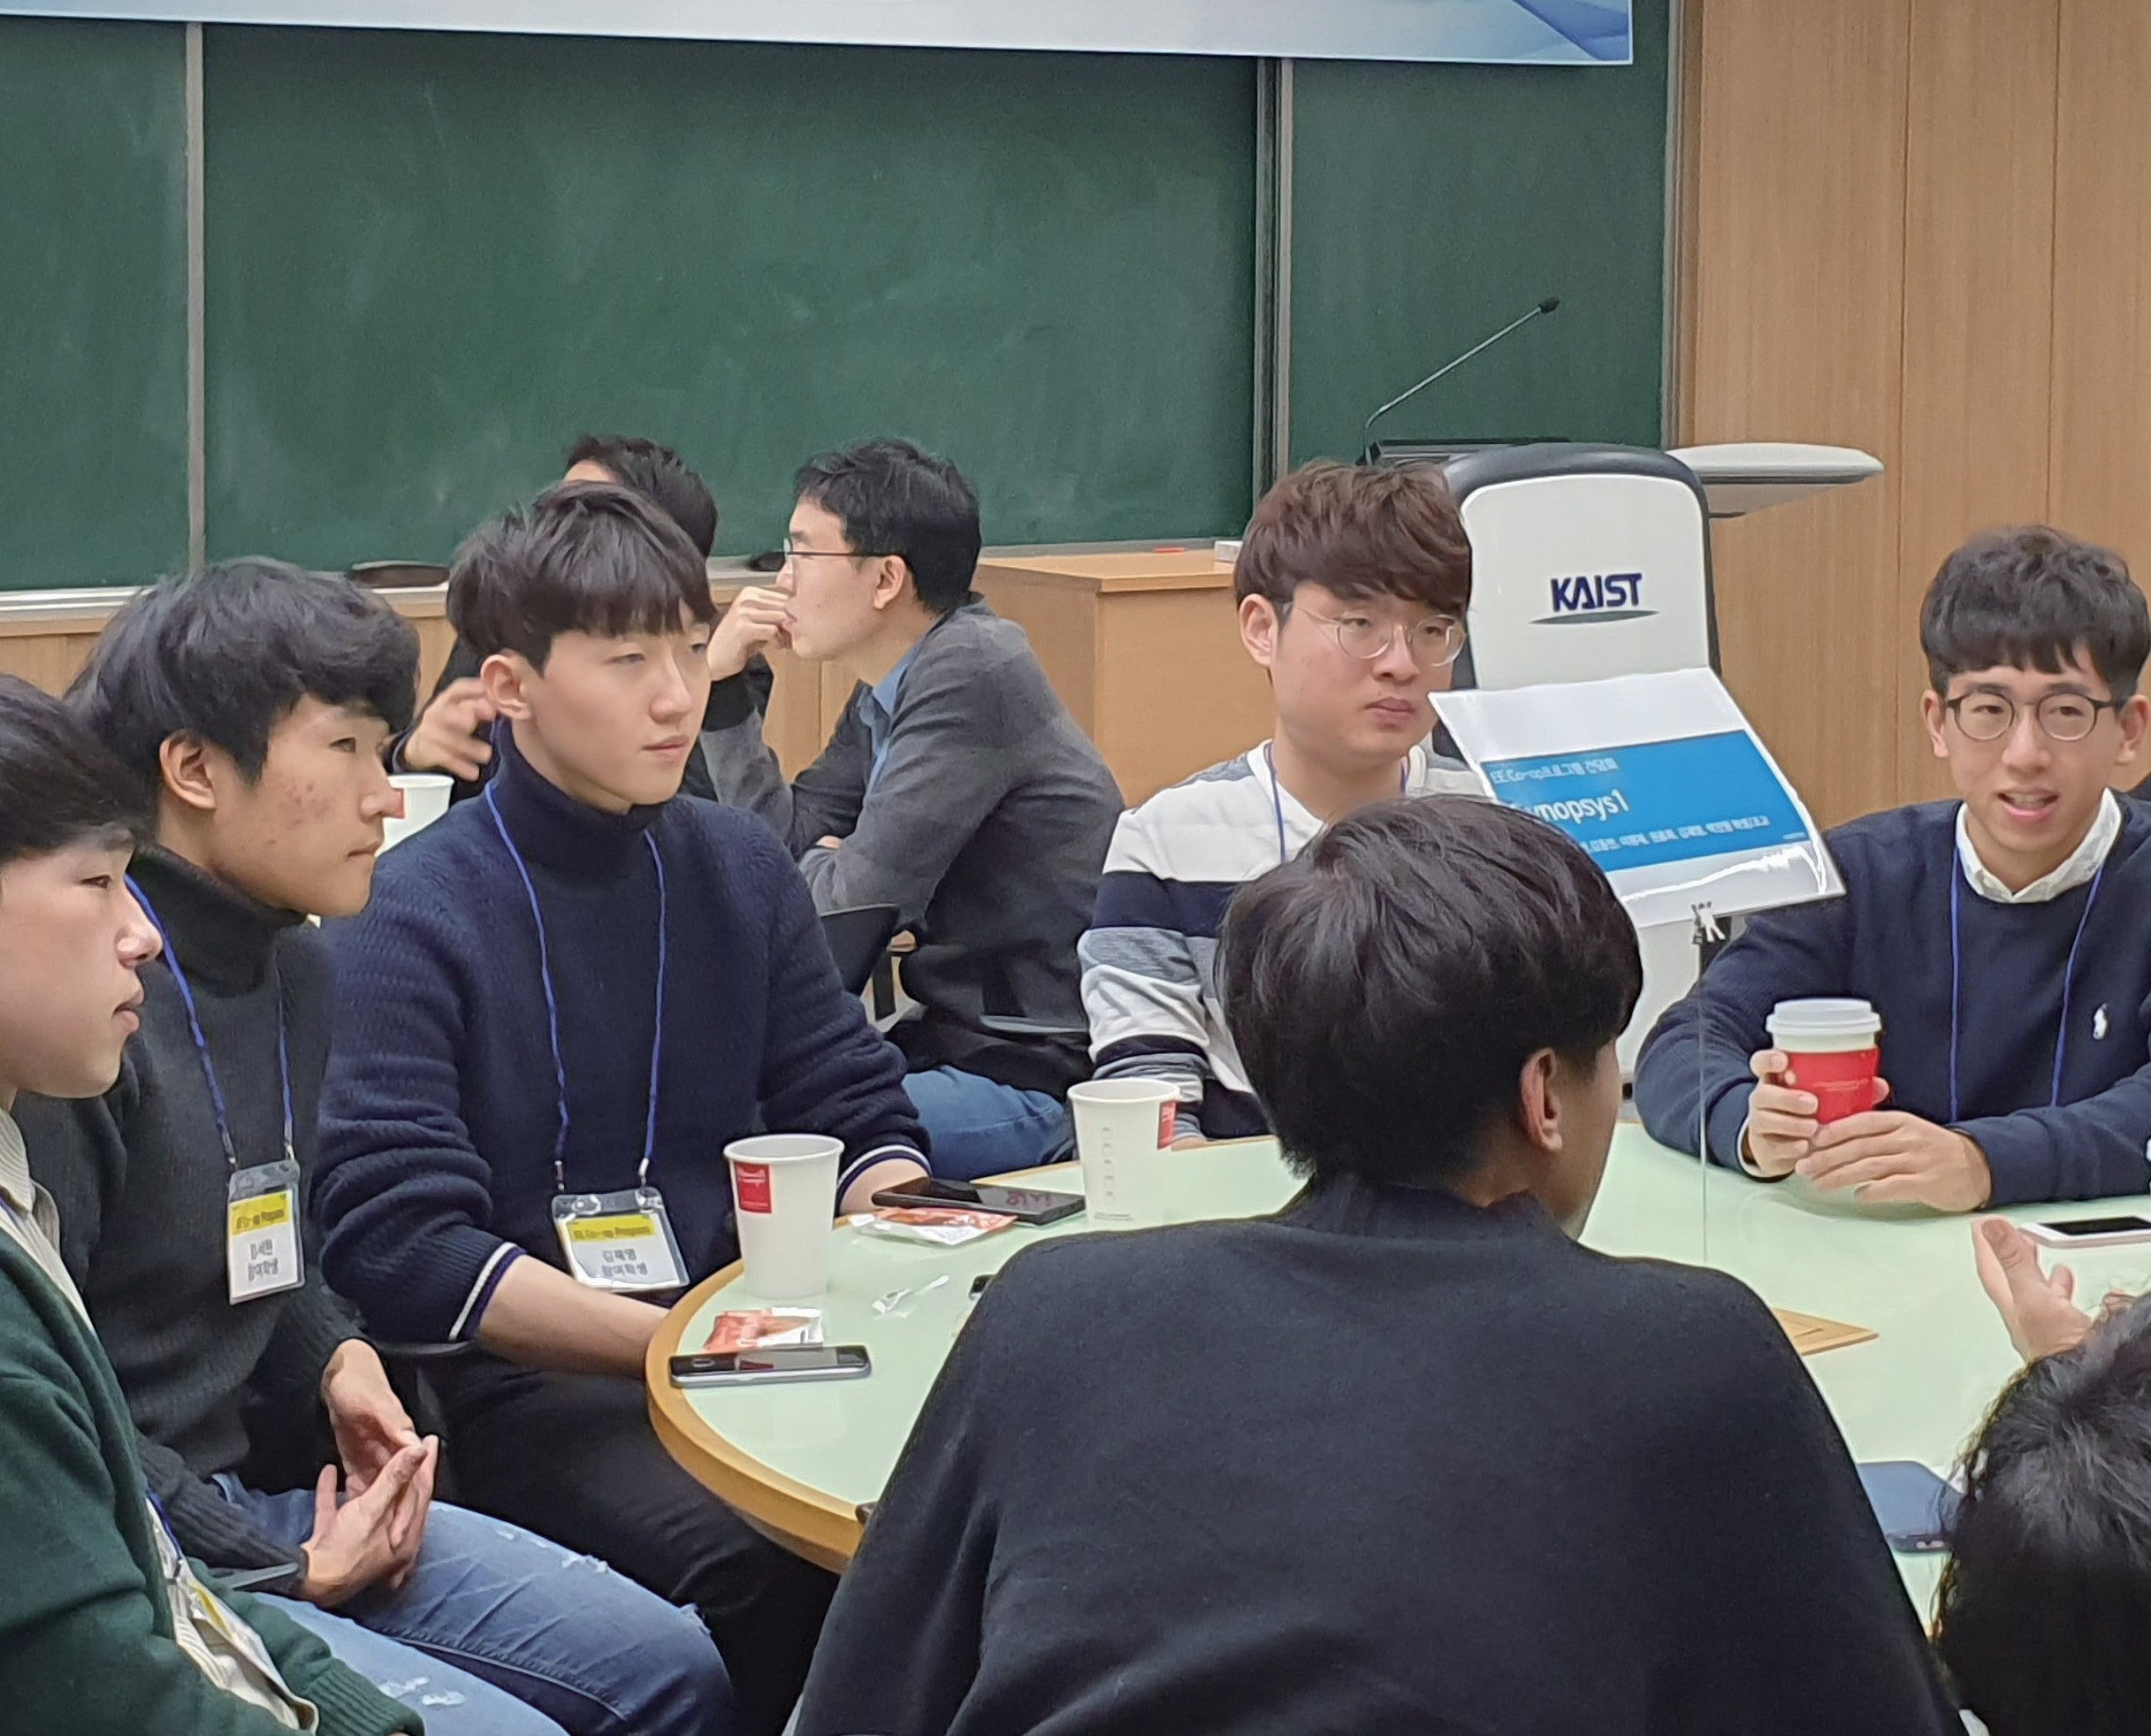
Co-Op Program
6+2 Hands-On Internship
Third and fourth-year undergraduates undergo up to six months of practical training at partner companies during a semester
Preceding their work, students engage in two months of individual research, aligned with company responsibilities, with designated labs and faculty guidance for a comprehensive understanding before the training
Externship Program for Tech Startup Entrepreneurs
Eight-week internship designed for third-year undergraduates and new graduate students
Focuses on connecting students with technology startups, small to mid- sized companies, and accelerators in the early-stage entrepreneurial venture ecosystem, offering hands-on experience

Slide 20
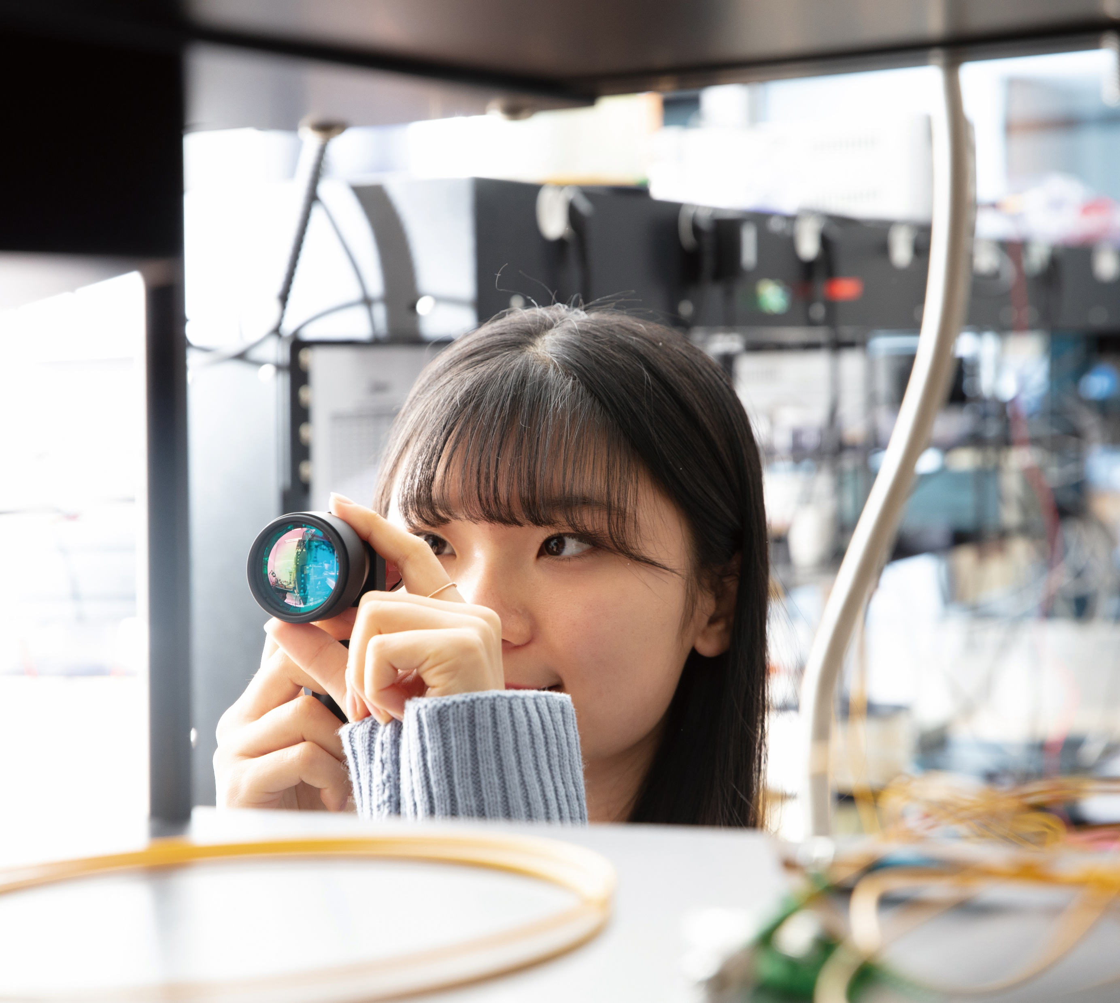
Research
Unraveling Creative Innovation

Slide 21
Collaborative Research Ecosystem
Emphasis on Collaborations
Across Public and Private
Sectors
39 Government-Funded
Research Centers &
87 Labs Drive Collaborative,
Multidisciplinary Research
Resulting Groundbreaking
Innovations
Significantly
Enhance
Education Excellence

Slide 22
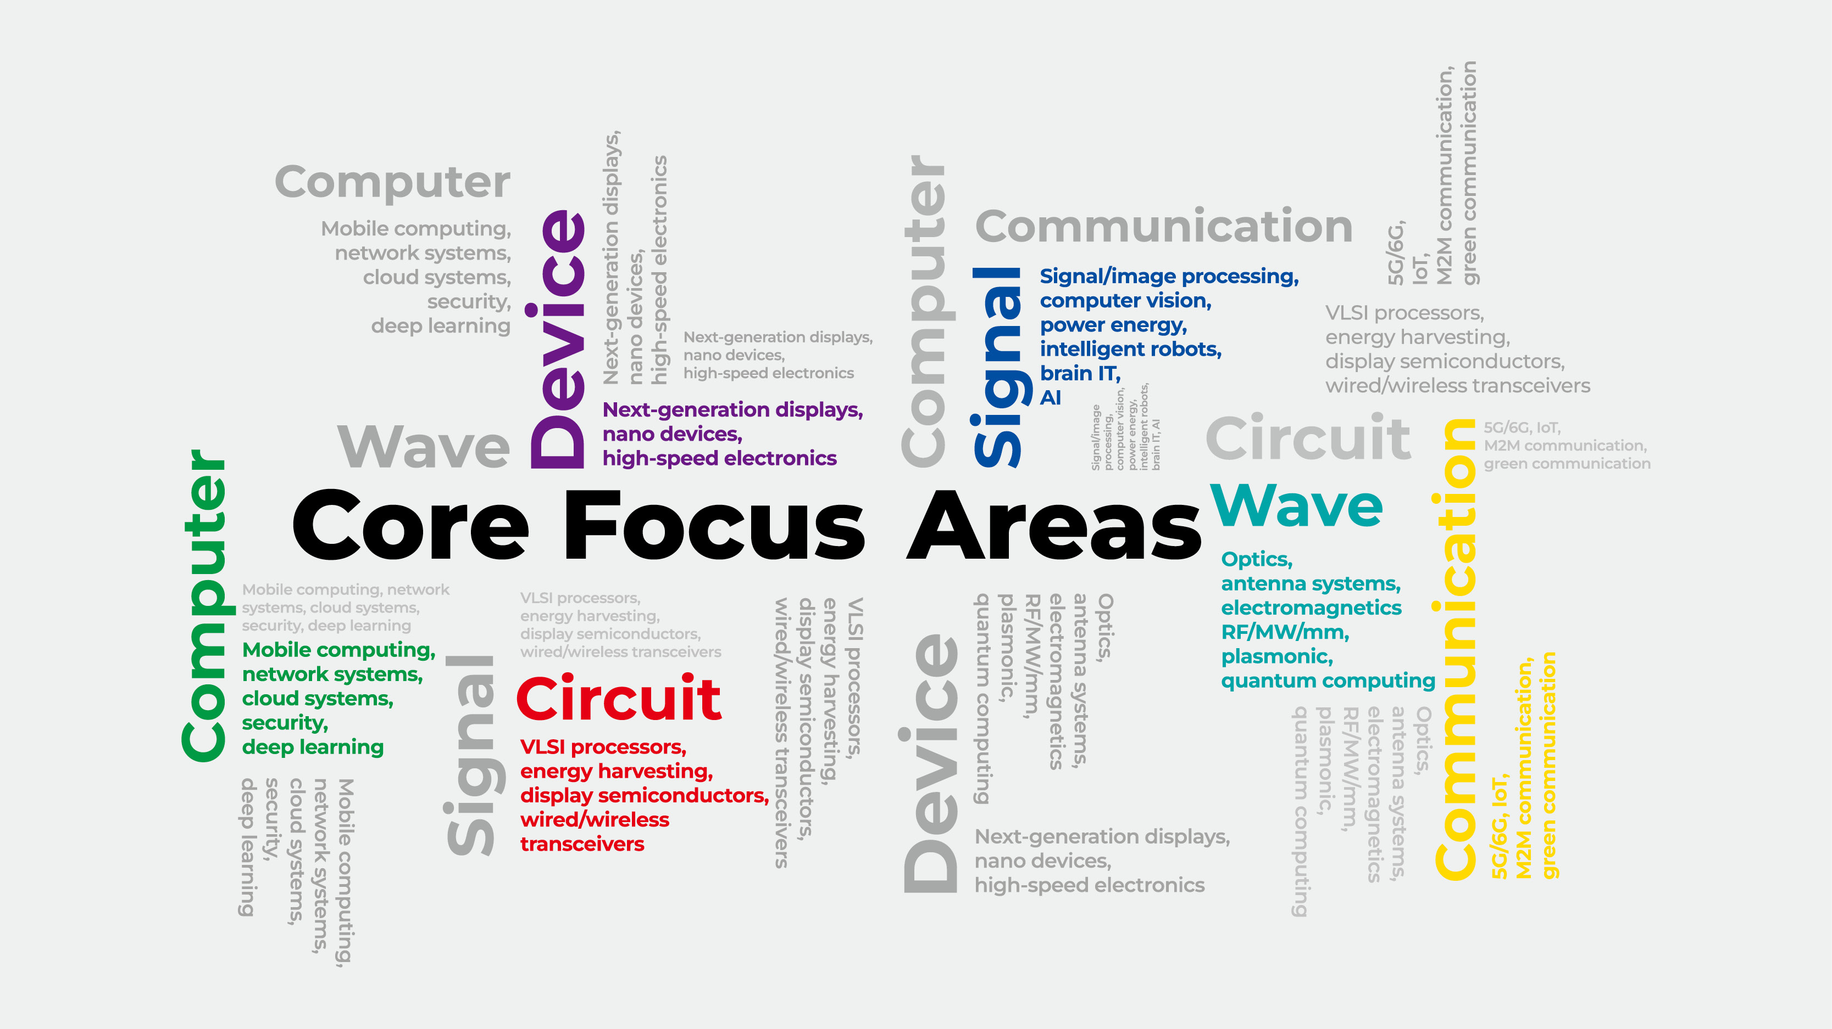

Slide 23

Research
Highlight

Slide 24
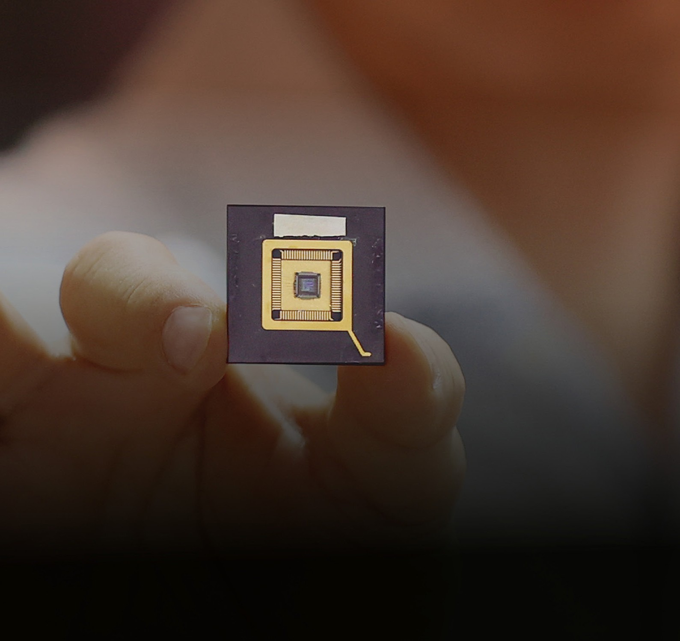
Transforming Tomorrow: AI+X Semiconductor Innovation
System Semiconductor Packaging Research Lab Professor Joungho Kim

Slide 25
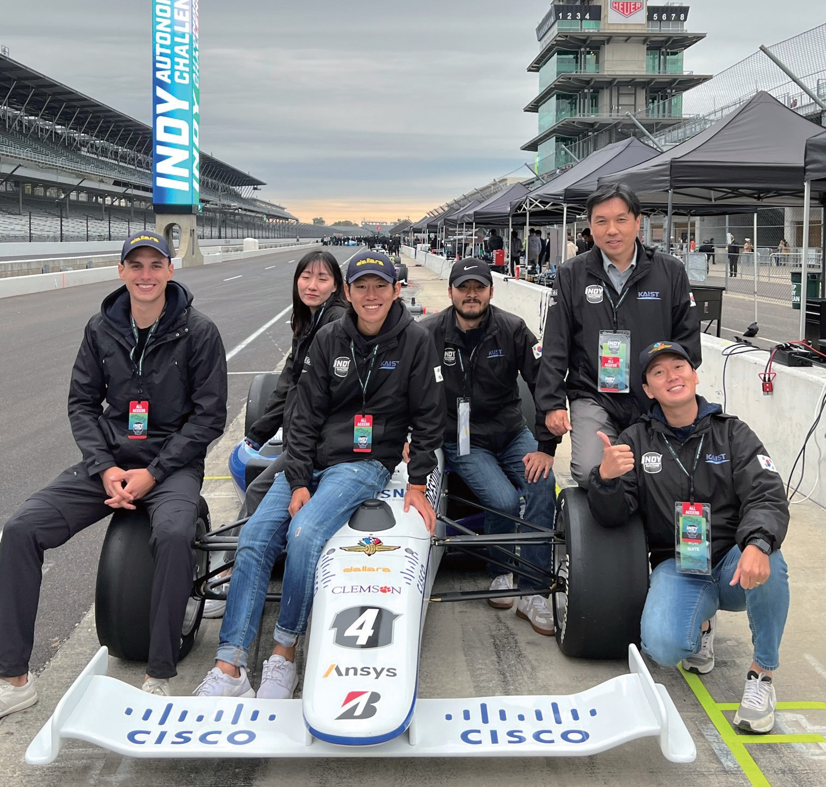
Making a Mark
in the Self-Driving Technology Industry
Unmanned Systems Research Group Professor Hyunchul Shim

Slide 26
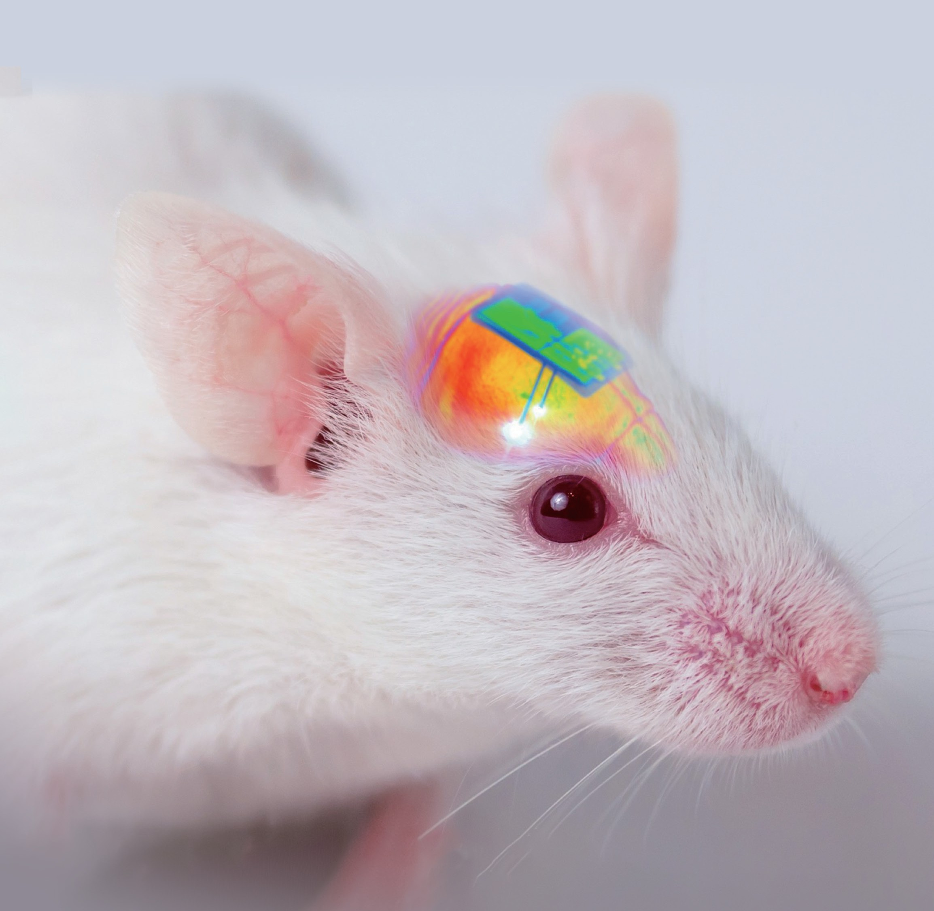
Wirelessly Rechargeable Soft Brain Implant Controls Brain Cells
Bio-Integrated Electronics and Systems Lab
Professor Jae-Woong Jeong

Slide 27
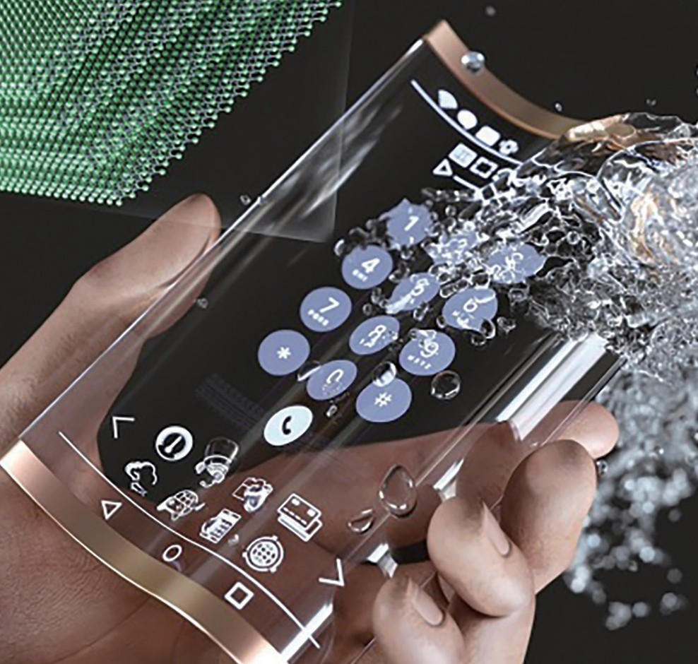
Washable and Flexible Transparent OLED Utilizing MXene Nanotechnology
Advanced Display and Nano Convergence Lab
Professor Kyung Cheol Choi

Slide 28
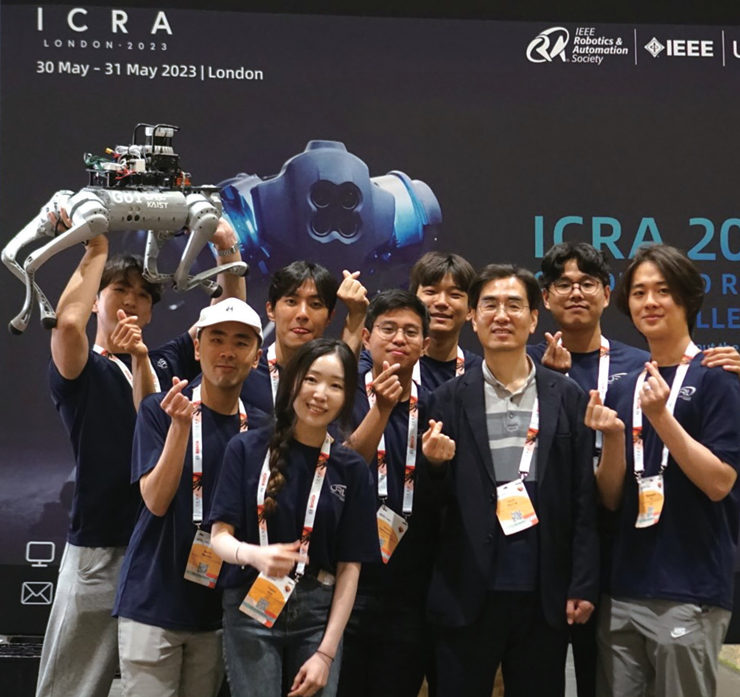



DreamWaQer :
A Quadrupedal Robot for Dark Environments
Urban Robotics Lab
Professor Hyun Myung

Slide 29
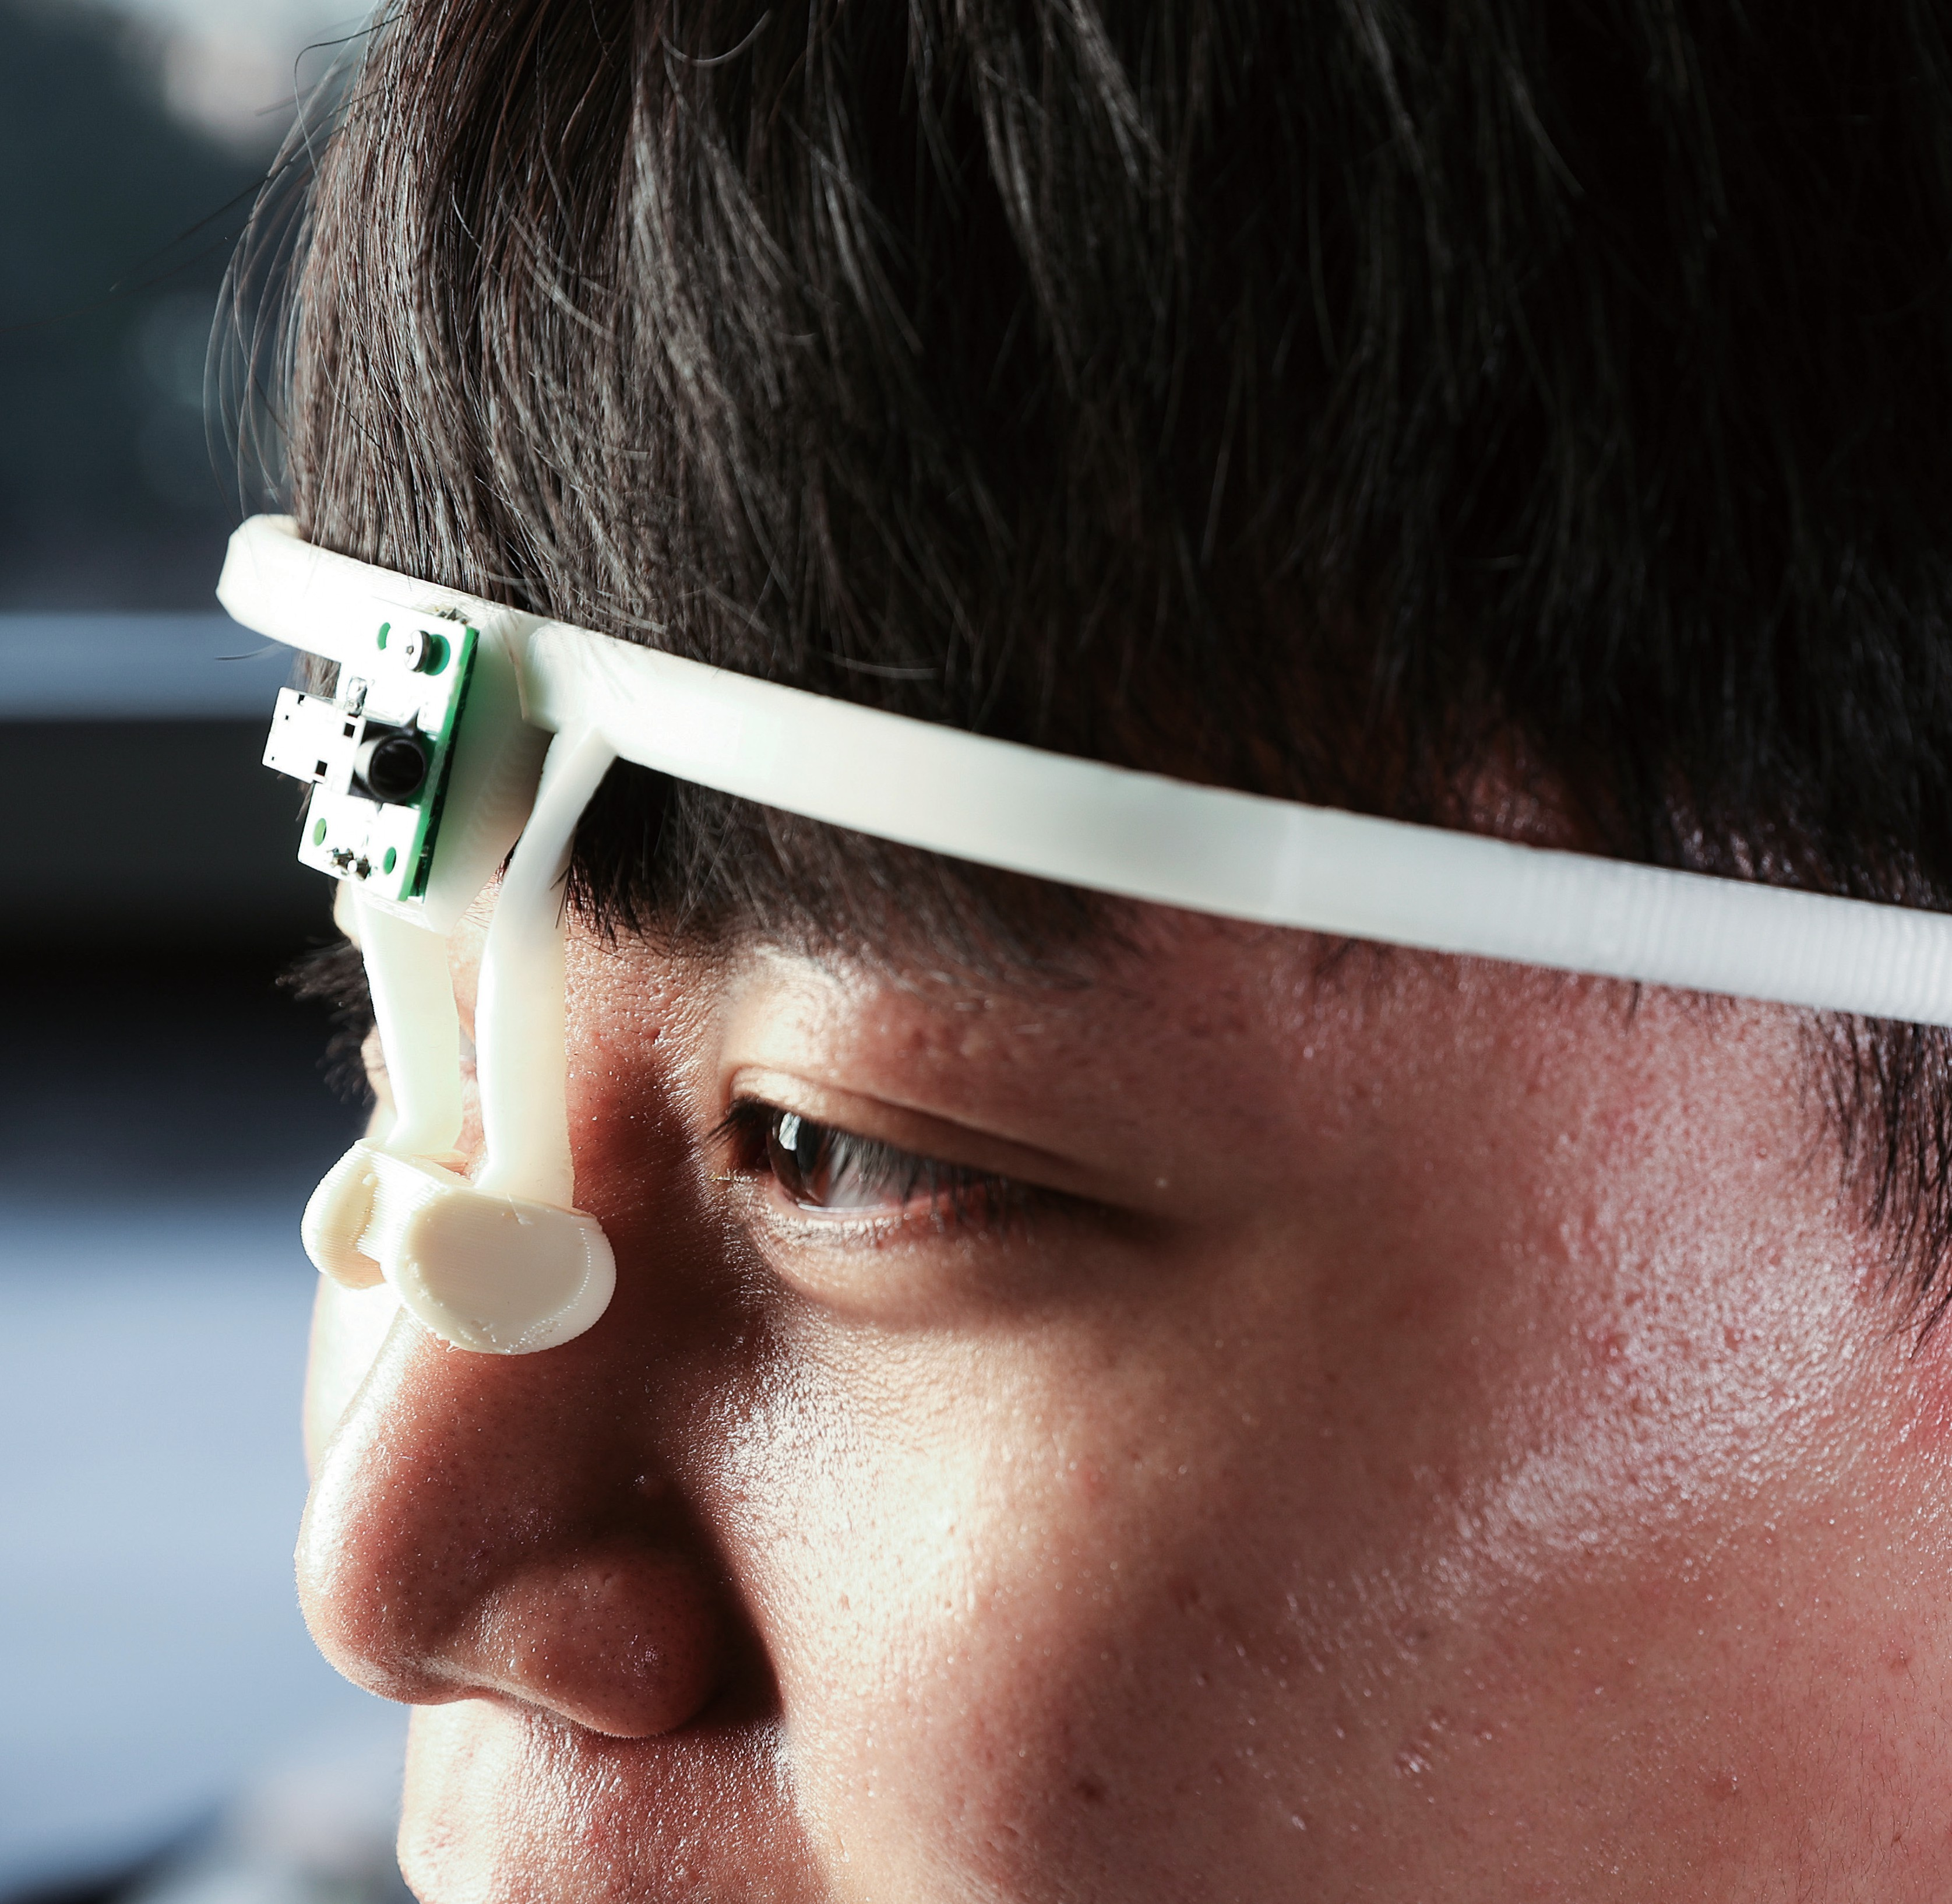
Smart Glasses Securing Access
in a Touchless Interface
Wearable and Interactive Technology Lab
Professor Ian Oakley

Slide 30

Global
Partnership
Expanding Global Horizons

Slide 31
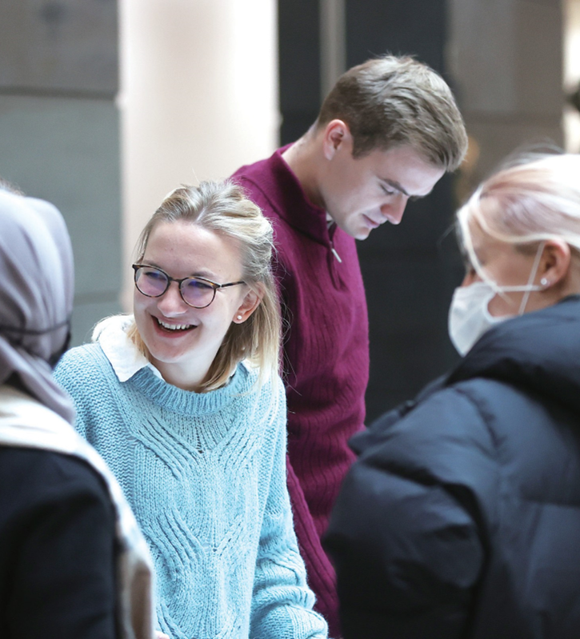
Global Partnership
330 Global Partners
International Dual Degree Programs
KAIST-Georgia Institute of Technology Dual BS 2+2 Program
KAIST-Technical University of Denmark MS 1+1 Program

Slide 32
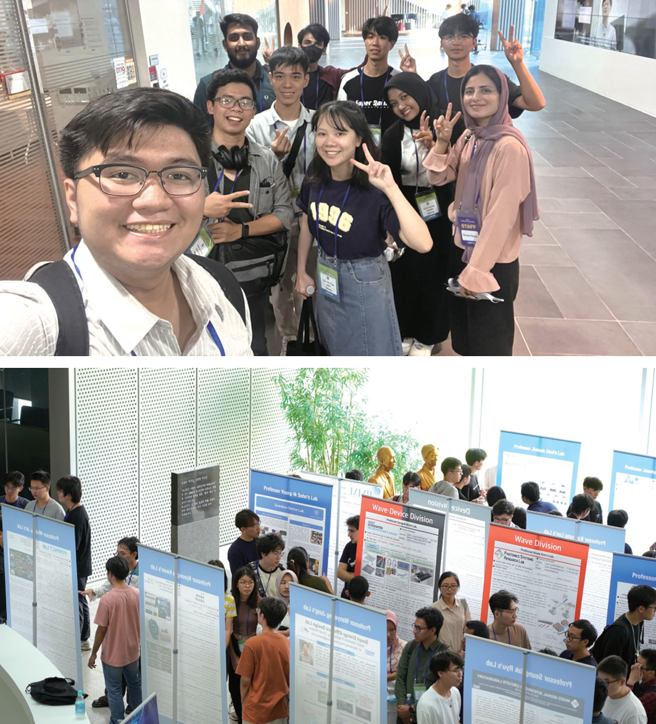
EE Visit Camp
Hosts undergraduates from partner universities exploring advanced studies at KAIST EE

Slide 33
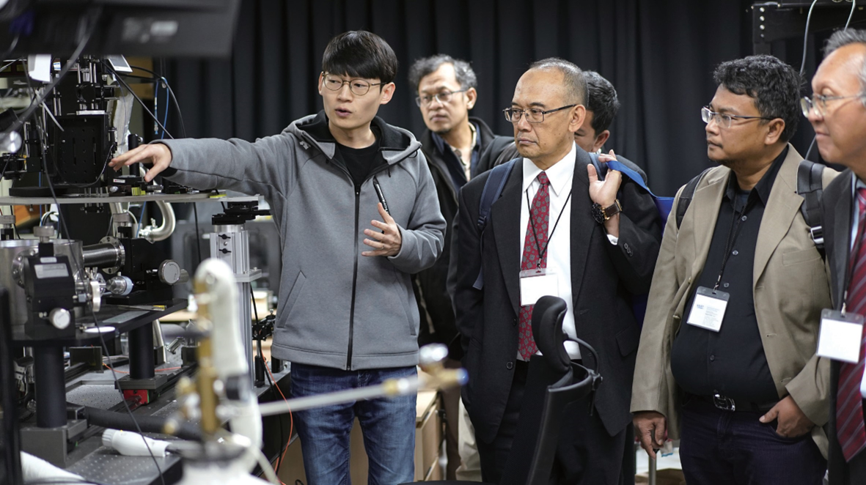
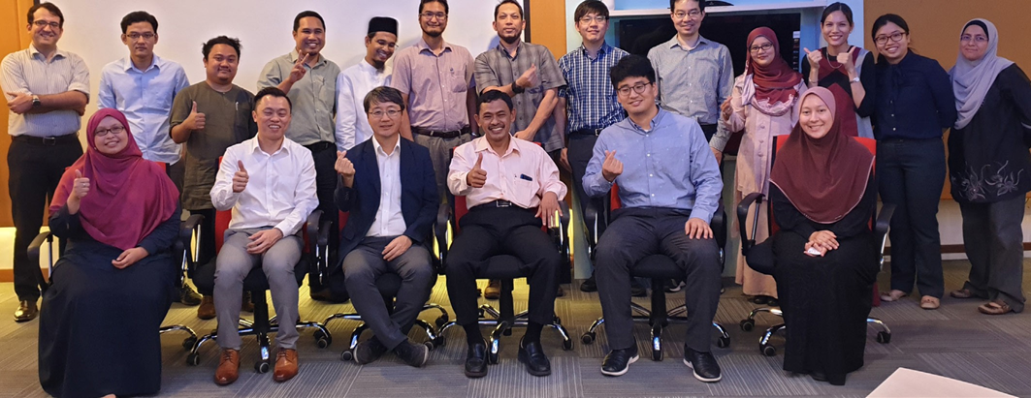
KEEP-I
Hosts esteemed professors from partner universities annually for research portfolio showcases to facilitate future collaborations

Slide 34

Entrepreneurship
Innovators Network Around the Globe

Slide 35
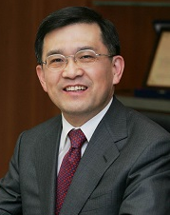
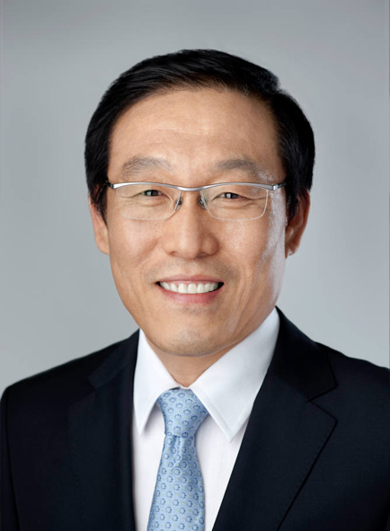
Leadership in Key Technology Industry
Around 9% of Samsung Electronics executives, including former CEOs Oh-Hyun Kwon and Ki-Nam Kim, are KAIST alumni
15% of SK Hynix executives also hail from KAIST, predominantly from the School of EE
Academic Influence
Graduates hold tenure-track faculty positions at 68 Korean universities and seven overseas institutions
Technological Pioneering
Alumni are instrumental in spearheading cutting-edge technologies in globally recognized IT companies

Slide 36

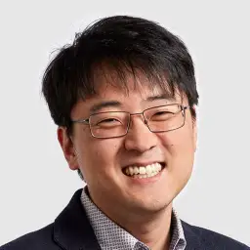
SiFive
Yoon-Sop Lee (BS '01)
Revolutionizing Chip Design
Based in Santa Clara, California, SiFive pioneers chip designs using open architecture RISC-V
Aims to disrupt Arm Ltd's dominance by supplying pivotal chip design components
Achieved a 2022 valuation of approximately 2.5 billion USD after a 175 million USD funding round

Slide 37

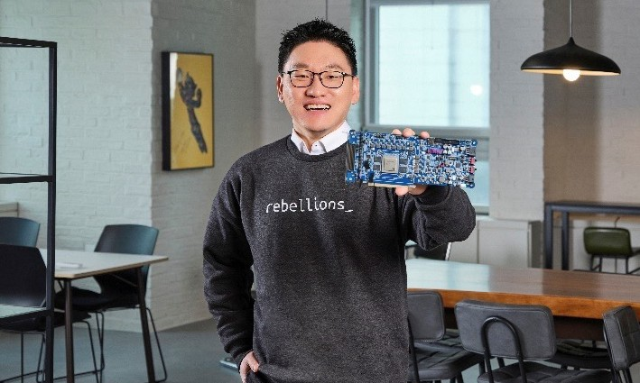
Rebellions Inc
Sunghyun Park (BS '02)
Pioneering AI Chip Design
A frontrunner challenging Nvidia in AI chip design and manufacturing
ATOM chip specialized for computer vision and chatbot AI, using about 20% of Nvidia's power for these tasks
Received over 76 million USD in investments within three years of establishment

Slide 38

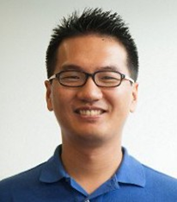
Lion Semiconductor
Won-Young Kim (BS ‘03)
Advancing Power ICs
Based in Silicon Valley, specializes in high-efficiency switched-capacitor power ICs for rapid wired and wireless device charging
Supported by prominent semiconductor investors like Walden Riverwood, Atlantic Bridge Ventures, and SK Hynix
Acquired by Cirrus Logic for 313 million USD in 2012

Slide 39

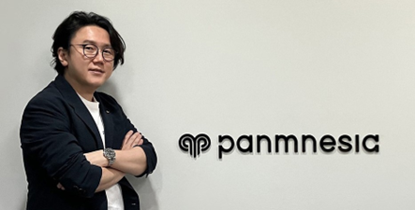
Panmnesia
Professor Myoungsoo Jung
CXL Technology Advancement
Fabless semiconductor company focused on advancing Compute eXpress Link (CXL) technology
Specializes in CXL Intellectual Property (IP) development, facilitating seamless connections among system devices
Enables dynamic memory utilization and cost-effective management in data centers, cloud, and high-performance computing
Secured $12.5 million in seed funding recently, solidifying its position as a semiconductor industry leader

Slide 40

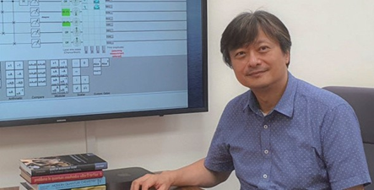
Qunova Computing
Professor June-Koo Kevin Rhee
Quantum Innovation
Pioneering Korea's foray into quantum computing
Focuses on quantum simulations and AI to revolutionize medication and materials research
Aims to provide sustainable solutions addressing global challenges

Slide 41

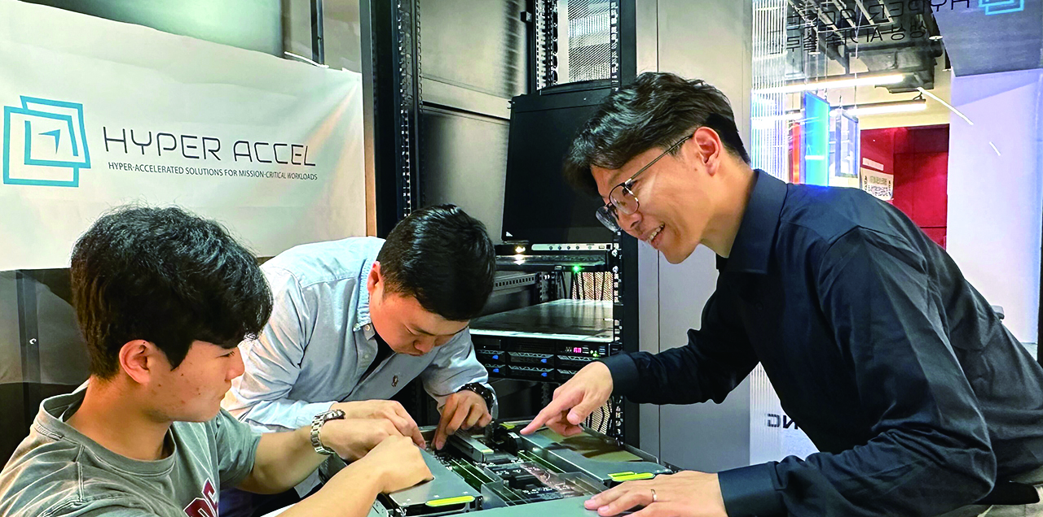
HyperAccel
Professor Joo-Young Kim
Advancing Generative AI
Develops a novel semiconductor infrastructure, enhancing generative AI accessibility
Designs processors and servers surpassing current GPU solutions
Innovations include the Latency Processing Unit (LPU), the first AI processor for generative AI, and the appliance server Orion.
Strategic partnerships with tech leaders in data centers, mobile, and edge computing, offering semiconductor IPs and low-power solutions

Slide 42
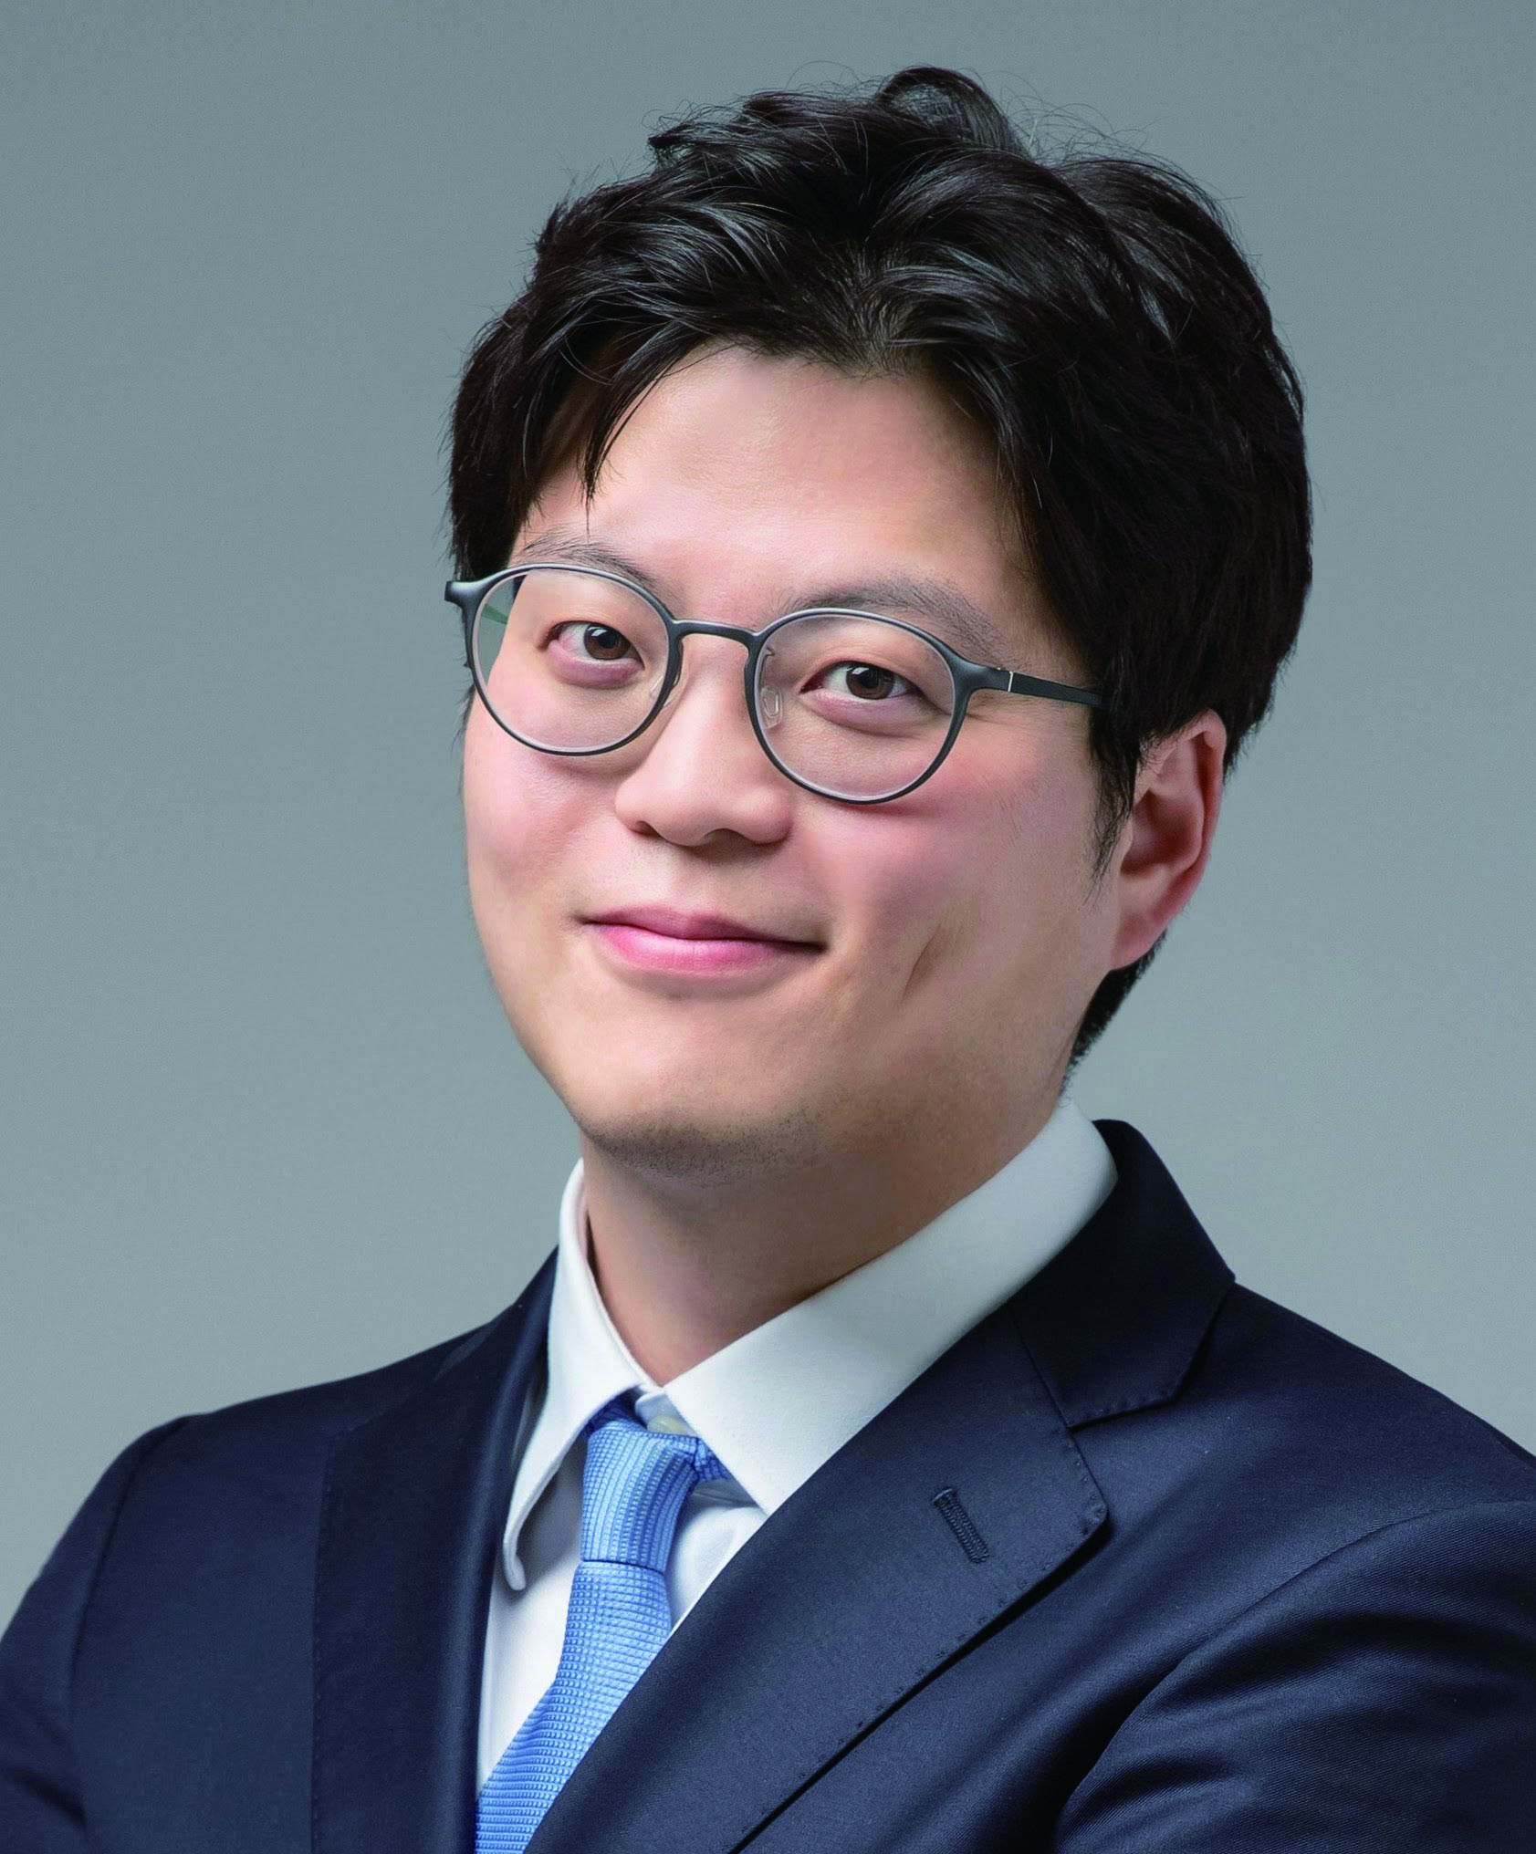
MilliTrack
Professor Song Min Kim
Precision RTLS Innovation
Elevates indoor Real-Time Location Systems (RTLS) with unprecedented precision and range
Introduces the world's first RF tag with 0.3mm accuracy, 150-meter range, and concurrent positioning of over a thousand tags in real-time
Utilizes millimeter-wave spectrum, ensuring a compact form factor, 40-year battery life, and cost-effective deployment
Revolutionizes high-precision robot control, immersive realities, and comprehensive monitoring in smart factories

Slide 43
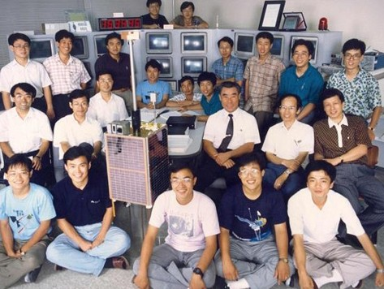
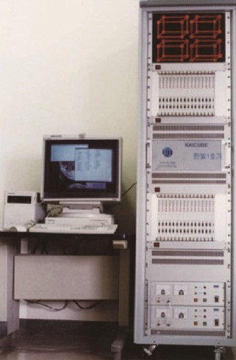
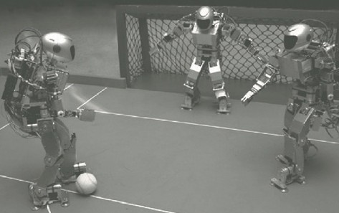
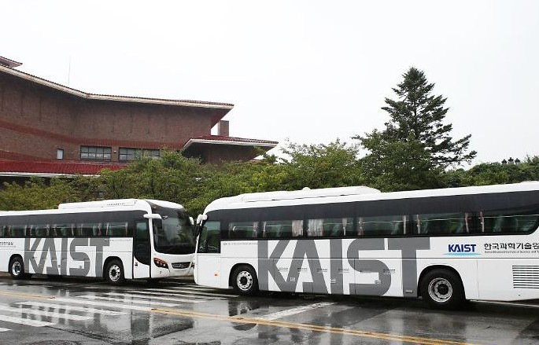
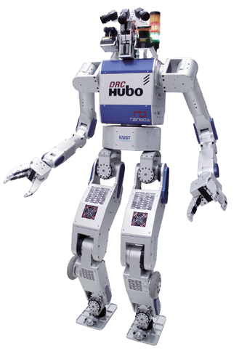
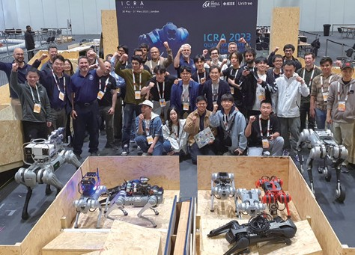

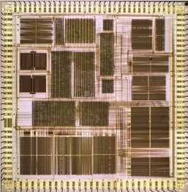
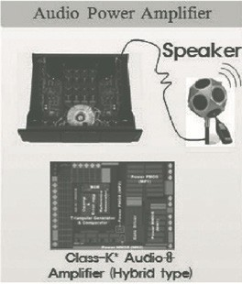
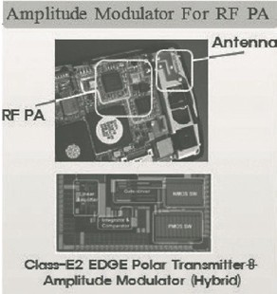
EE Trailblazers: Driving Korea’s Technology Forward
1975
Pioneer’s Invention Ignites
the Era of Korean Microwave Ovens
Professor Jung-Woong Ra
1986
Korea’s Space Exploration
Begins with KITSAT-1 Launch Professor Soon-Dal Choi and Professor Dan-Keun Sung
1995
Supercomputing
Revolution – the Birth of Habit-1
Professor Kyu-Ho Park
1995
Robot Soccer Takes Root at
KAIST
Professor Jong-Hwan Kim
2009
Wireless Charging Electric Bus Paves the Way for Future Mobility
Professor Dong Ho Cho
‘
2015
Hubo Wins DARPA Robotics
Challenge
Professor In So Kweon
2023
DreamWaQer Wins the 2023
Quadruped Robot Challenge
Professor Hyun Myung
1986
Innovative Radar Technology
Unveils North Korean Tunnel Threat
Professor Jung-Woong Ra
1995
1995: Korea’s Microprocessor
Milestone - The Birth of HK 386”
Professor Jong-Min Kyung
1999
First Faculty Startup with
High-Performance Audio Amplifier
Professor Gyu-Hyeong Cho

Slide 44
